Slide 1
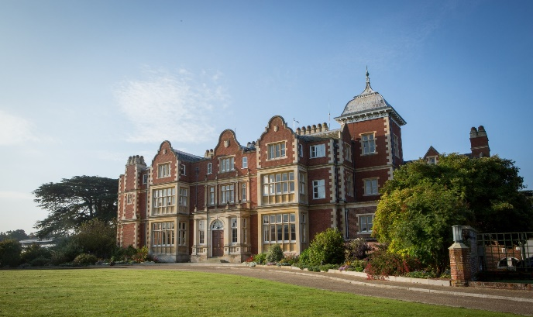
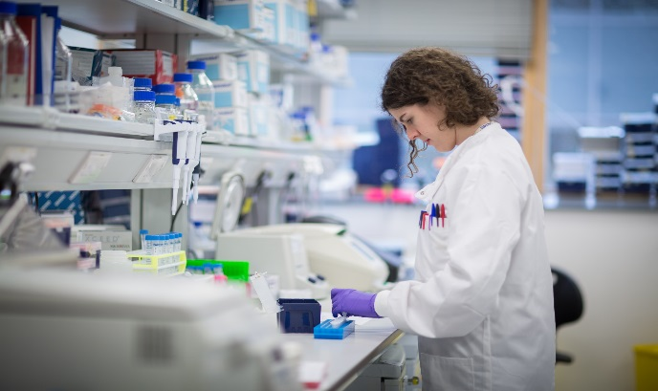
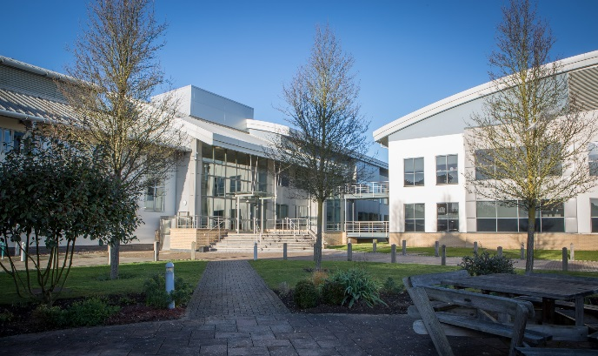
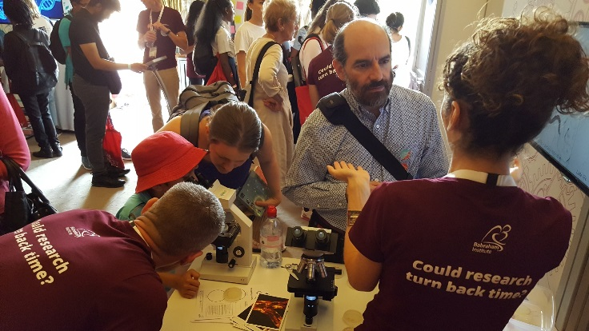

Genomics – Decoding DNA
@babrahaminst

Slide 2
Learning Outcomes
All students will: | Provide an example of what information DNA can tell us.
Most students will: | Be able to describe the structure of DNA and its bonding.
Some students will: | Describe the process of sequencing DNA.
Key word/s | genomics, DNA, sequencing, mutation, nucleotides, genetic code

Slide 3
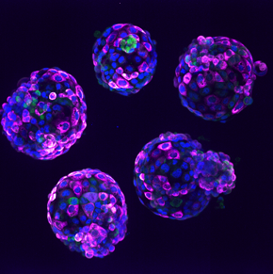
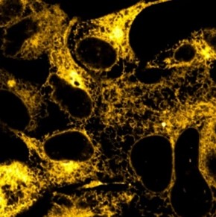
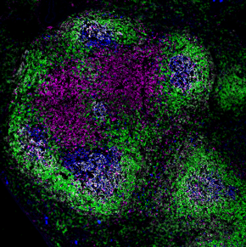
Babraham Institute research themes
Epigenetics – How reversible modifications to DNA can control access to genetic information. Epigenetic changes can be linked to ageing and the effects of our environment.
Signalling – How chemical pathways inside cells allow them to adapt their function and behaviour in response to changes in their surroundings. Control of these pathways can change with age and contribute to illnesses.
Immunology – How cells in the immune system develop, specialise and are regulated to respond to infections. The strength of the immune response declines sharply with advancing age.
Notes:
For more information - https://www.babraham.ac.uk/our-research

Slide 4
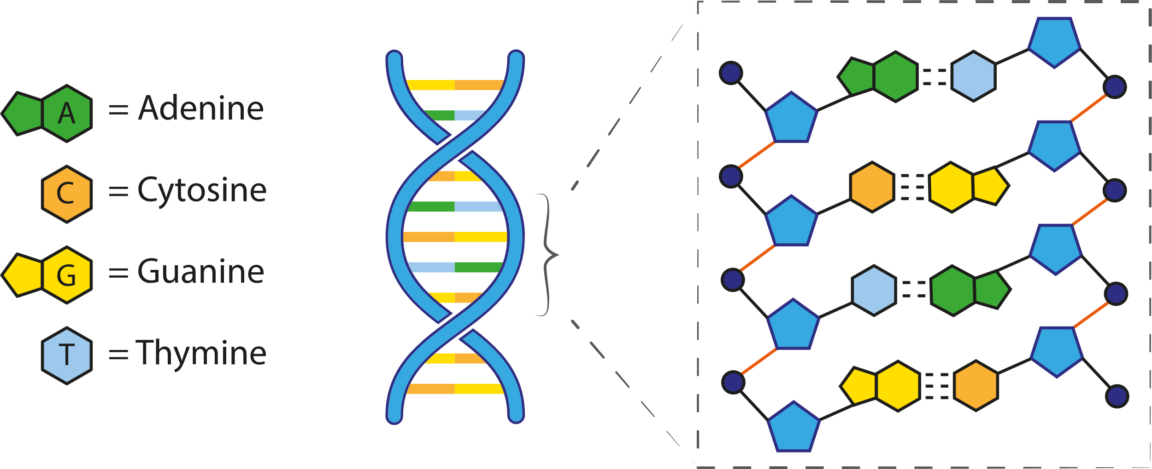
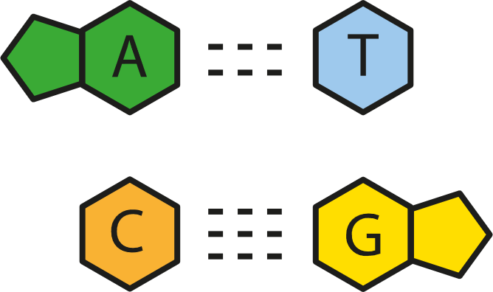
Starter: What is DNA?
DeoxyriboNucleic Acid
Notes:
DNA stands for DeoxyriboNucleic Acid
Stores the genetic information in our cells
Made up of 4 bases: adenine, thymine, cytosine, guanine
Complimentary pairs A – T (2 hydrogen bonds) and C – G (3 hydrogen bonds)

Slide 5
Starter: What is DNA?
DeoxyriboNucleic Acid
Sugar-phosphate backbone
DNA
Nucleotide bases
Notes:
Made up of 4 bases: adenine, thymine, cytosine, guanine
With a sugar-phosphate backbone held together by phosphodiester bonds
Red = phosphodiester bonds

Slide 6



Why do we want to know what the DNA 'code’ is?
Learn more about diseases
Be able to identify people
Learn how genes control our bodies
To know if we are at risk of disease
To tailor treatments to individual patients
Notes:
order of bases = determines genes (functional or not) which is important to know when we want to treat heritable/genetic diseases like sickle cell anaemia

Slide 7
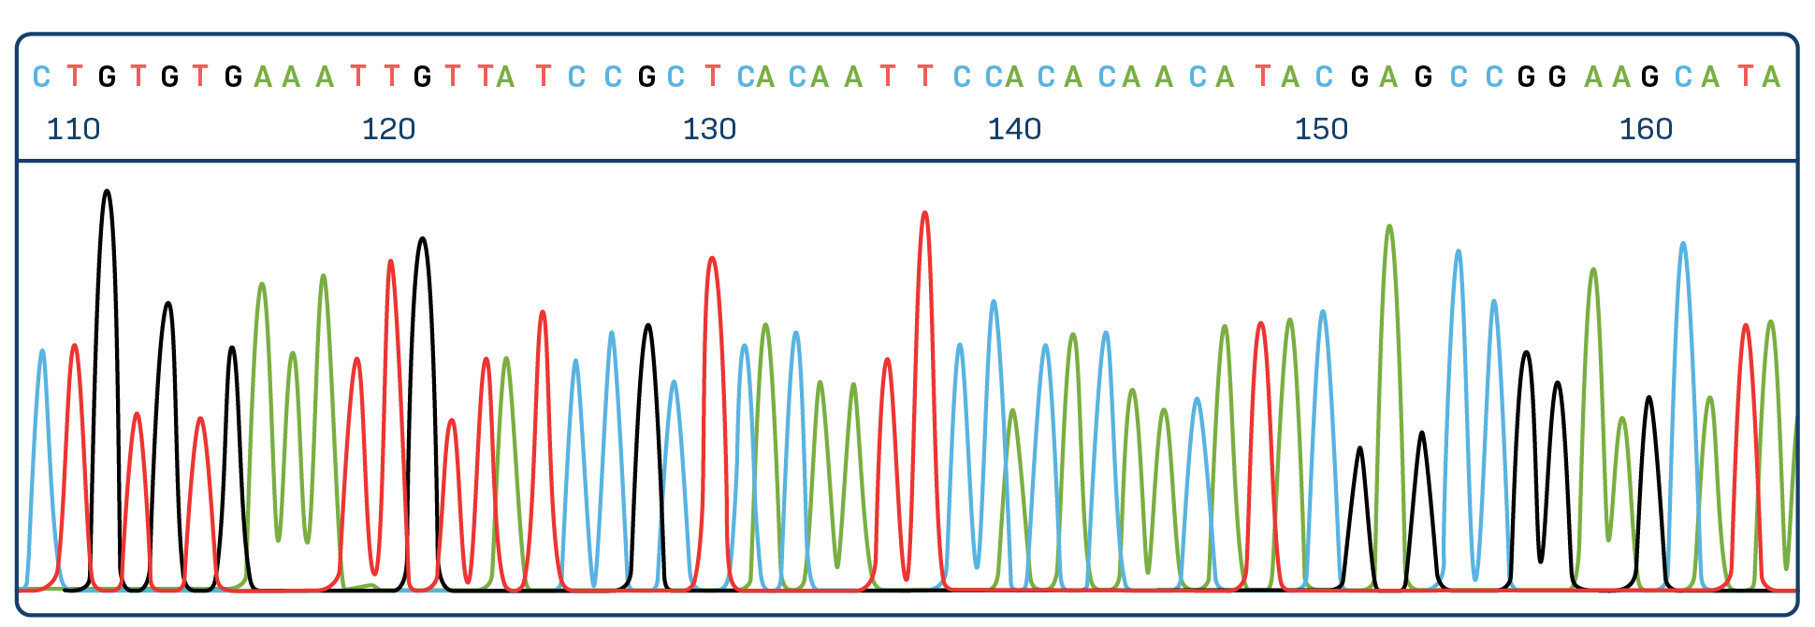
What is genomics?
Genomics describes the study of all of a person's genes in their entire genome
  Only about 1% of the genome codes for proteins
  The other 99% plays a role in regulating gene expression and some areas have no known function
Notes:
Genomics describes the study of all of a person's genes (the entire genome)
Only about 1% of the genome codes for proteins
Genome = the complete set of genes or genetic material present in a cell or organism.
Whereas Genetics is the study of genes and how 'traits' are passed down from one generation to the next

Slide 8
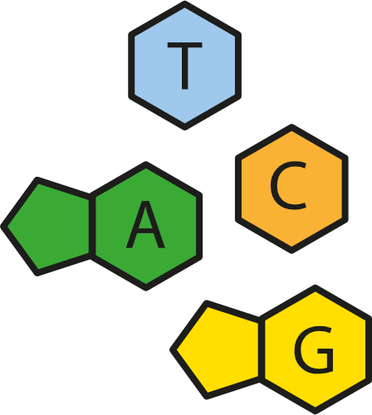
What is sequencing?
Sequencing is a method to determine the exact sequence of bases in our genetic code
First invented in 1977 by Frederick Sanger, using a method now known as Sanger sequencing
  replicates DNA with radioactively labelled chain-terminating nucleotides generating many different length DNA fragments
  separated fragments according to size using electrophoresis and expose them to x-ray film
  sequence read based on order of nucleotides on x-ray film
New technologies such as Next Generation Sequencing have made it faster and cheaper to sequence DNA
Notes:
Sanger sequencing is very time consuming! It took 13 years to complete The Human Genome Project (completed in 2003)
We are now able to sequence a human genome in around day
NGS uses Polymerase Chain Reaction (PCR) to amplify DNA which is much quicker

Slide 9
What can sequencing tell us?
Sequencing can detect mutations in our genome
  Insertions, deletions, substitutions
  Gene amplifications
It can detect genetic variation between people
  Small changes in our DNA called Single Nucleotide Polymorphisms (SNPs)

Slide 10
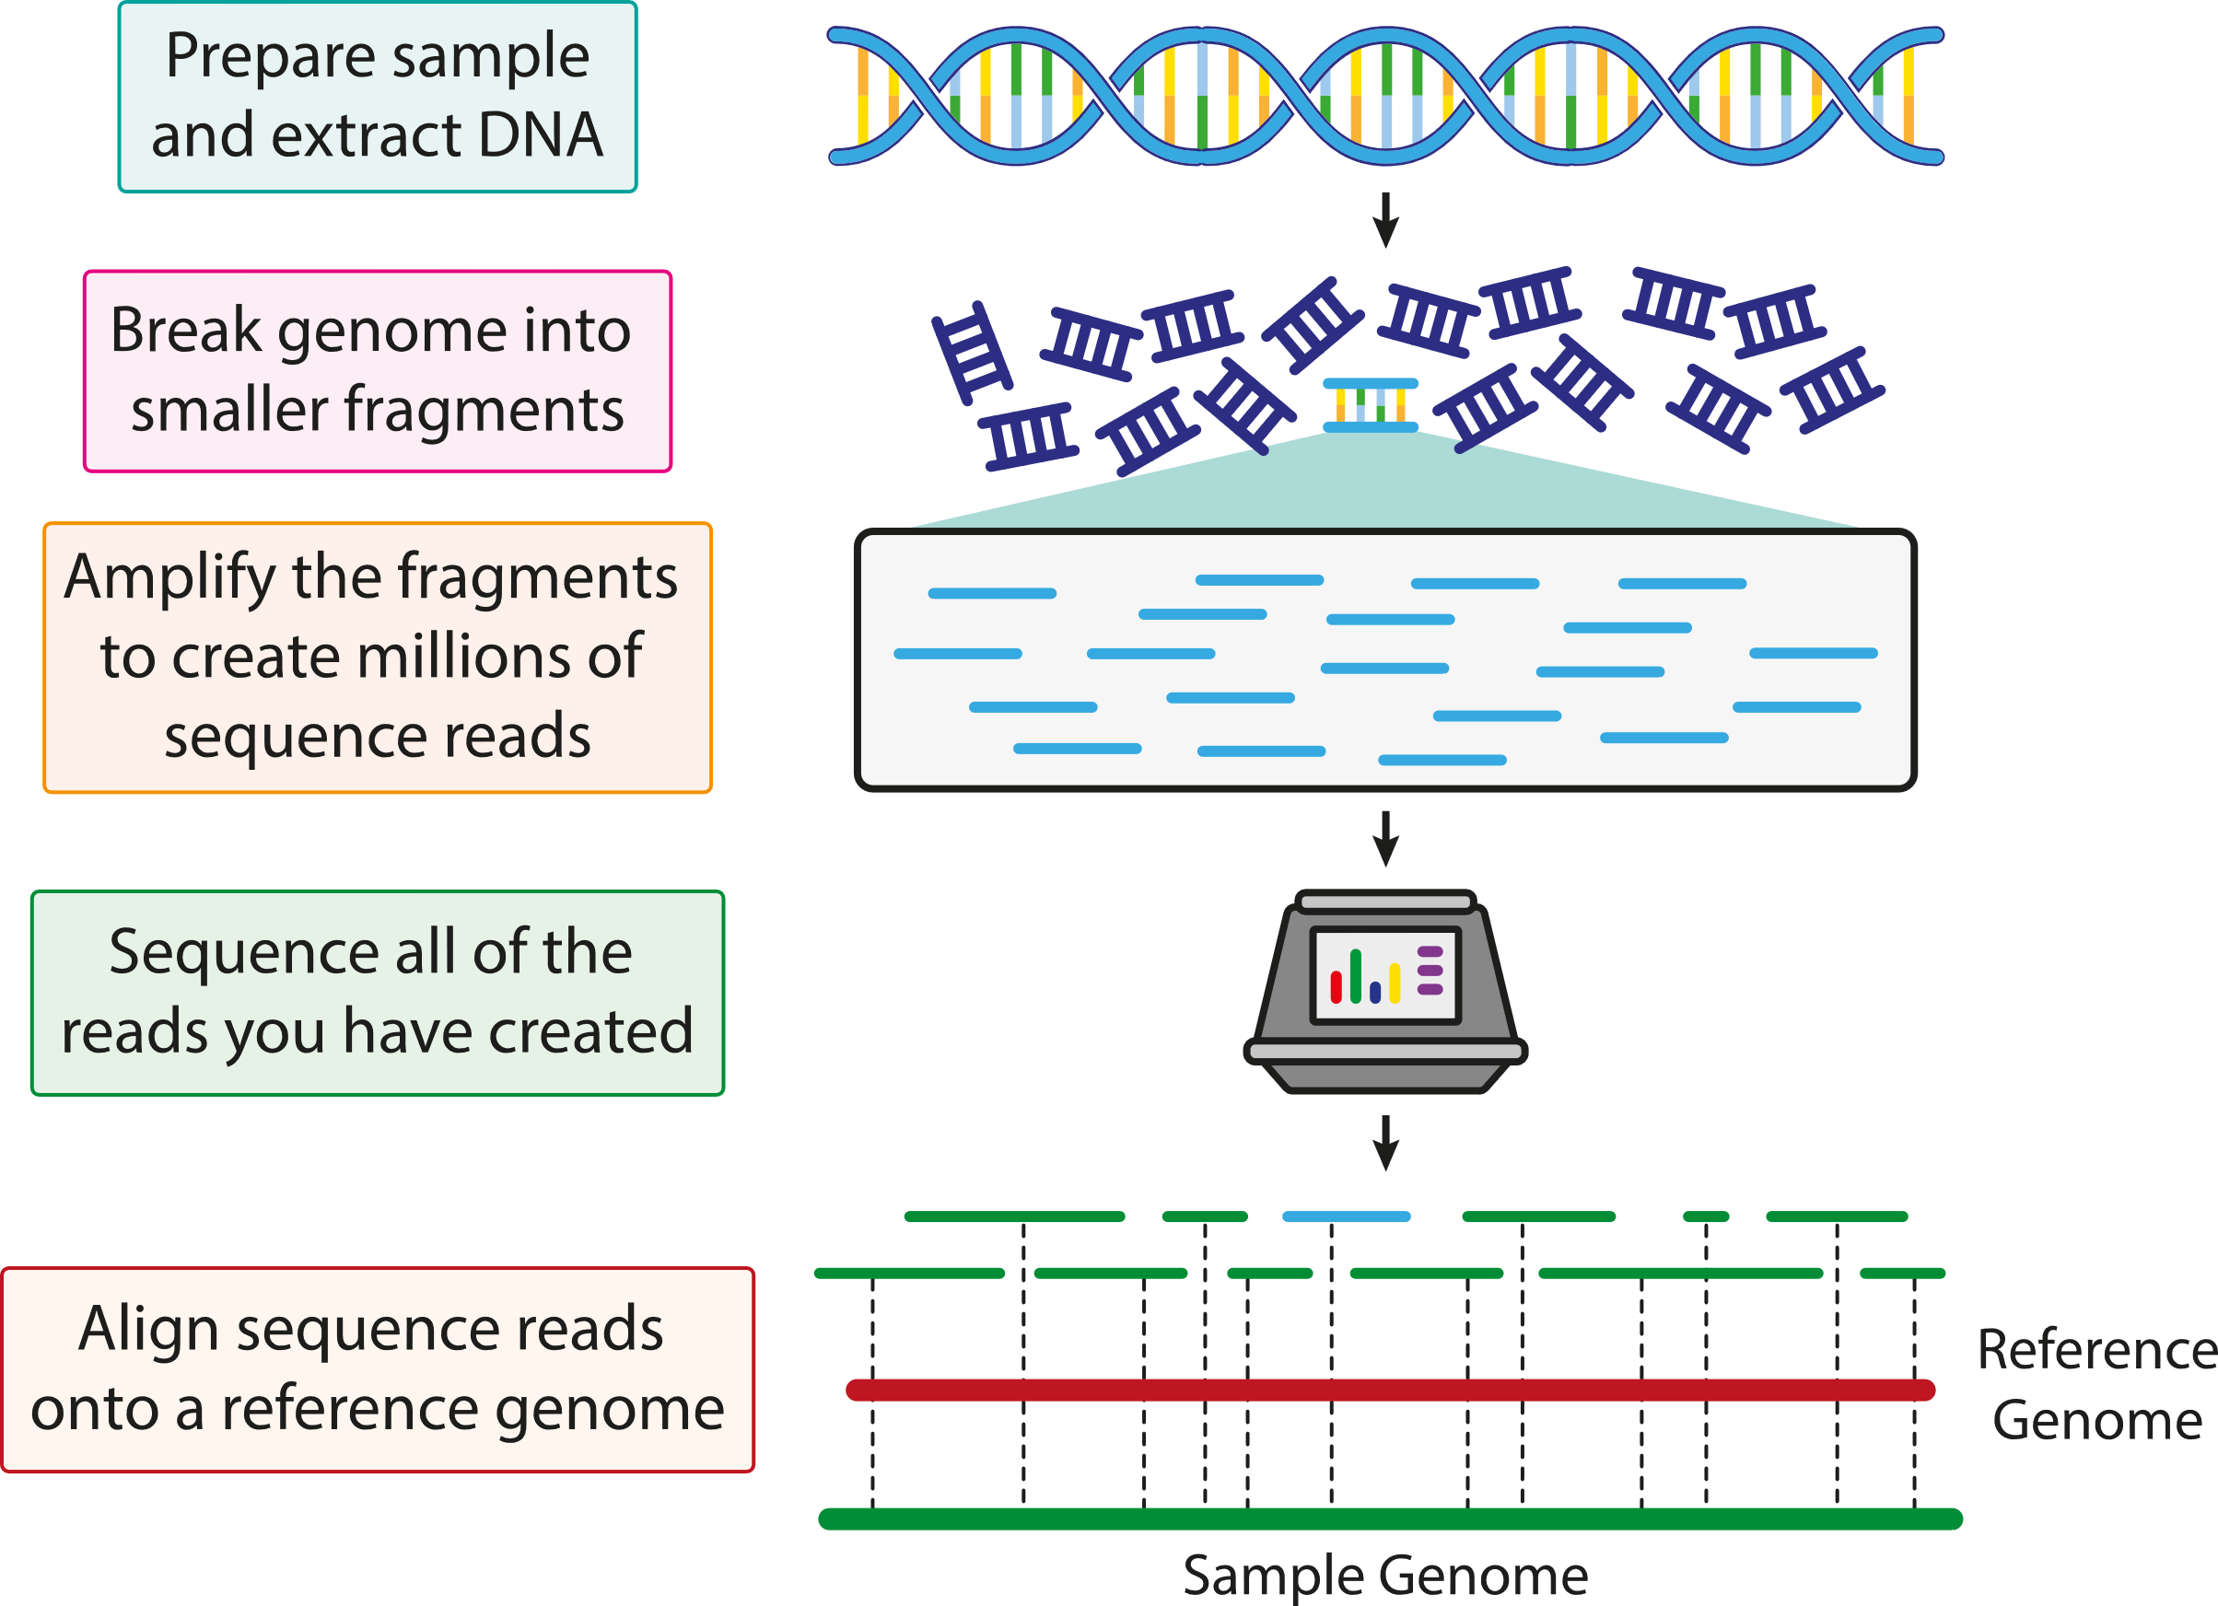
Sequencing

Slide 11
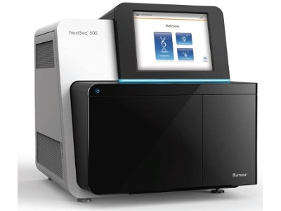
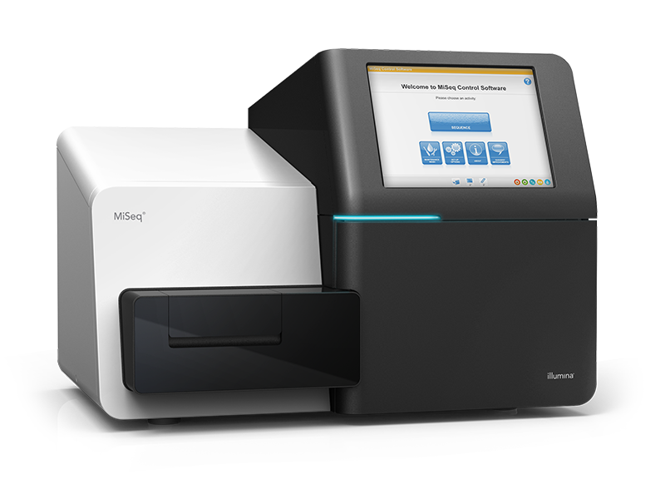
Sequencing at Babraham Institute
NextSeq 500 System Whole-Genome Sequencing​
all the protein-coding and non-coding parts of the DNA ​
75-300 bp reads​
Takes between 12-30 hrs​
Generating 20-120GB of data​
MiSeq System​
targeted approach, looking at specific regions in the DNA ​
50-600 bp reads​
Takes between 4-56 hrs​
Generating 0.5-13.5GB of data​
Notes:
Bp reads = the length in base pairs of a DNA fragment, known as a read

Slide 12
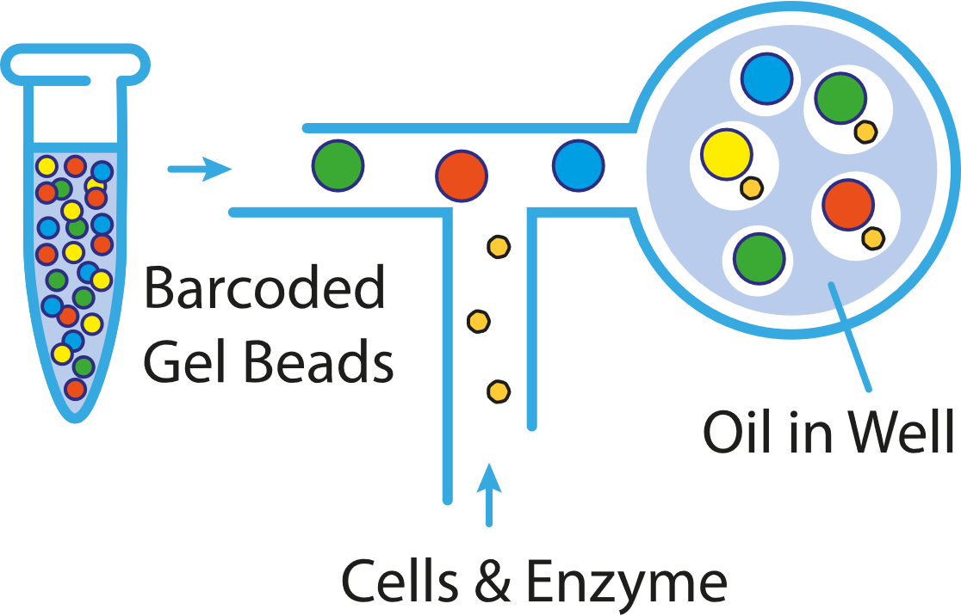
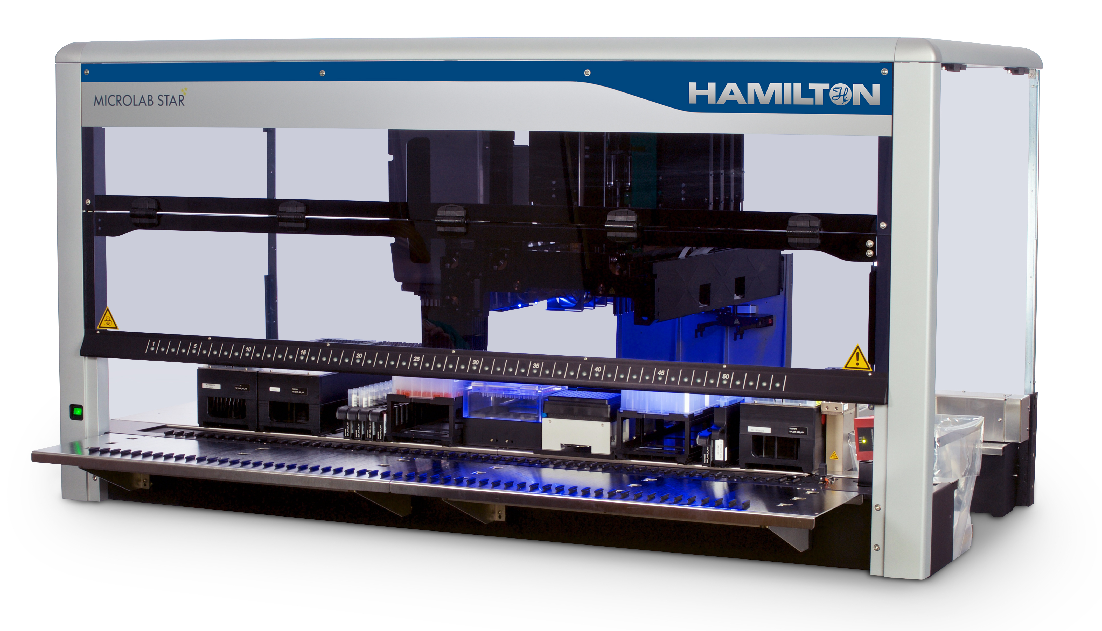
Sequencing at Babraham Institute
10x Genomics Chromium Controller
Able to separate a sample into single cells
Each cell is labelled or ‘barcoded’ in order to tell them apart during analysis
Hamilton GNS star for library preparation
High throughput workflow for large library processing
Up to 96 samples at once

Slide 13
Activity: Decoding DNA
VS
X X
C T T A
O
X O
C A T C
A T T G
Notes:
Explain how to play mastermind:
The code maker writes down their DNA code made up of the 4 nucleotide bases (ATCG)
The code breaker will then have 10 guesses to crack the code
After each guess the code maker will place an X or O, letting you know if you have any correct letters and if they’re in the correct place
The code breaker who guessed the code quickest wins (least number of guesses)

Slide 14
Recap
DNA contains all our genetic code
Sequencers read short pieces of DNA fragments
We can sequence DNA across the whole genome or a specific region
New technologies allow us to sequence an entire genome in one day

Slide 15
More information…
For more information about the Genomics facility at Babraham
https://www.babraham.ac.uk/science-facilities/genomics
For more information about research at Babraham
https://www.babraham.ac.uk/our-research

