Slide 1



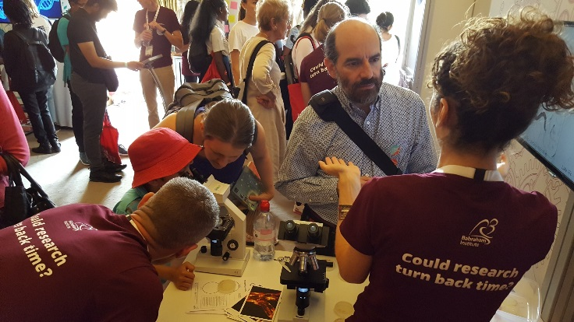

Fair Testing
@babrahaminst

Slide 2
Learning Outcomes
All students will: | Be able to explain what makes an experiment fair
Most students will: | Provide results on which paper towel is best following a fair test
Some students will: | Explain the different types of variables that are required to make a test fair
Key word/s | Test, fairness, experiment, practical

Slide 3
Starter: Which of these is a fair test?
We wanted to find out how much water plants need to make them grow well. We took six germinating plants and gave them the different amounts of water each day. Three were kept on the window sill and three on top of the cupboard.
We wanted to find out how long it took parachutes made of different materials to fall to the ground. We made them the same size and dropped them from the same height. We then timed how long each took to fall.

Slide 4
What is fair testing?
It is only by carrying out a fair test that you can be sure that…
…what you have changed…
…is affecting what you measured

Slide 5
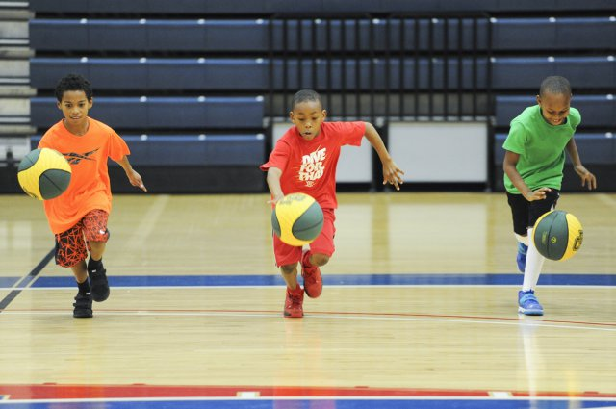
So what are variables?
Variables are all the things that could change during an investigation
In an investigation to find out which ball bounces best, what could change from one experiment to the next?
  The ball
  The drop height
  Anything else?
Notes:
CC –
Basketball - https://www.army.mil/article/160135/baylor_basketball_team_holds_youth_camp_at_fort_hood

Slide 6

What sort of variables are there?
You should only change one thing in your experiments
This called the independent variable
What would it be in the
bouncing experiment?
Notes:
CC - https://commons.wikimedia.org/wiki/File:Sport_balls.svg

Slide 7

What sort of variables are there?
The factors you keep the same in your experiments are called control variables
What could they be in the
bouncing experiment?
Notes:
CC - https://commons.wikimedia.org/wiki/File:Twemoji2_26f9-1f3fe-200d-2640-fe0f.svg

Slide 8
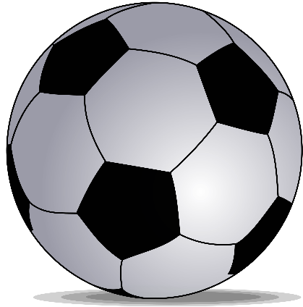
What sort of variables are there?
As a result of your experiment your results should show something changing
This is called a dependent variable
What would it be in the
bouncing experiment?
Notes:
CC - https://commons.wikimedia.org/wiki/File:Soccerball_mask_transparent_background.svg

Slide 9
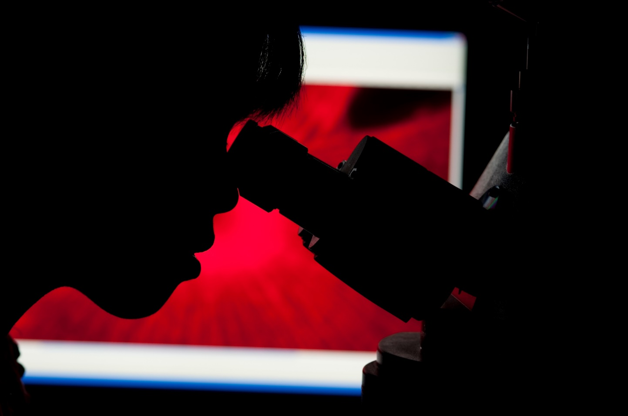
How can we get our results?
Observation?
Notes:
CC - https://commons.wikimedia.org/wiki/File:Observing_through_a_Microscope_(9955277825).jpg

Slide 10
Which horizontal line is longer?
Notes:
Both lines are the same length – we need accurate measurements and not to rely on our eyes

Slide 11
So how can we be sure of our results?
Observing is important but in science there are often times when we need to measure things as well as observe them
To measure things we need instruments or equipment
Notes:
CC - https://pixnio.com/science/chemistry/chemistry-liquid-glass-research-laboratory-medicine

Slide 12
How can we get our results?
What measuring instruments would you use to measure the following?
  The length of a piece of string
  The temperature of water in a beaker
  The mass of a stone
  The swing of a pendulum (time)
  The volume of water in a test tube
A ruler/tape measure
A thermometer
Scales/balance
A stopwatch
A measuring cylinder

Slide 13
Activity: Your experiment
A fair test to see which paper towel is the most absorbent?
Equipment:
  Paper towels
  Water
  Something to measure?
  Anything else?

Slide 14

Activity: What are our variables?
Independent variables?
  The paper towel
Control variables?
  How much water you start with
  Any time measurements
Dependent variables?
  How much water it soaks up
Notes:
CC - https://www.pexels.com/photo/scientific-calculator-ii-5775/

Slide 15
Activity: Your experiment
How will you design your experiment?
  Dip the towel into the water?
  Pour the water onto the towel?
  Something else?
  Remember, you ALL must use the SAME method!

Slide 16
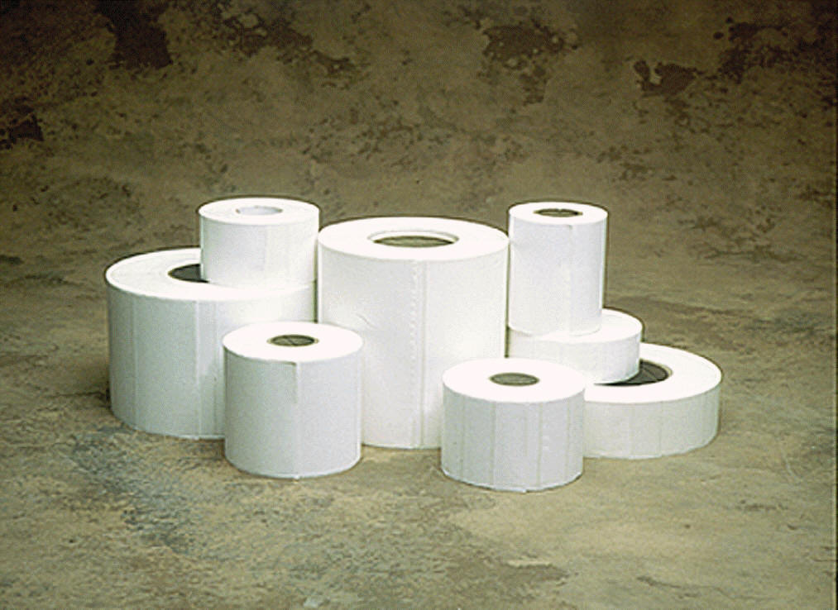
Let’s do the experiment
Groups
Equipment
Record results
Notes:
Split into groups of 5ish
CC - https://en.wikipedia.org/wiki/File:Thermal_Transfer_Labels.jpg

Slide 17
…and the answer is….
Paper Towel | Absorption

Slide 18
Recap
What is a fair test?
What are the three types of variable?
What can be the downside to relying on observation to get our results?
What types of measuring instruments could we use?
Notes:
A fair test is when you can be sure that what you have changed is affecting what you have measured.

